Slide 1
Erasmus+ Capacity Building in Higher Education
Strengthening innovative social
entrepreneurship practices for disruptive business settings in Thailand and Myanmar
Projectref.: 609711-EPP-1-2019-1-AT-EPPKA2-CBHE-JP
Duration: 36 Months (15/01/2020-14/01/2023)

Slide 2
This course consists of four sequential modules:
DAY 1
Training 1 - Introduction to Social Entrepreneurship and Opportunity identification
Welcome and intro
Training 2 – Social Business model and planning for social innovation
Training 3 – Branding & Marketing strategies for SE
Training 4 – How to implement a training sentre (SEKH)
02
Notes:
Training 1 - Introduction to Social Entrepreneurship and Opportunity identification
Training 2 - Business modelling and sourcing
Training 3 - SE communication strategies
Training 4 - SE Hubs

Slide 3
Agenda
03
Notes:
Co znajduje się w tym szkoleniu

Slide 4
Today’s agenda
DAY 1
8:00 (EU) | 12:30 (MMR) | 13:00 (THA) | Welcome and intro
8:15 (EU) | 12:45 (MMR) | 13:15 (THA) | Warm up
8:30 (EU) | 13:00 (MMR) | 13:30 (THA) | Introduction to group activity
8:45 (EU) | 13:15 (MMR) | 13:45 (THA) | Social enterprises – work in teams
9:05 (EU) | 13:35 (MMR) | 14:05 (THA) | Sharing session
9:50 (EU) | 14:20 (MMR) | 14:50 (THA) | Break
10:10 (EU) | 14:40 (MMR) | 15:10 (THA) | Presentation of EU Case
11:10 (EU) | 15:40 (MMR) | 16:10 (THA) | Break
11:25 (EU) | 15:55 (MMR) | 16:25 (THA) | Working in teams on a specific SE challenge
12:10 (EU) | 16:40 (MMR) | 17:10 (THA) | Wrap up session
04
Notes:
Co znajduje się w tym szkoleniu

Slide 5
We ask for a representative of each partner to introduce the team by name and 1 fun fact
Warm up
05

Slide 6
Introduction to group activity
06

Slide 7
Definition of social entrepreneurship
Social entrepreneurship encompasses all entrepreneurial approaches to addressing social needs. It is a wide umbrella concept that refers to employing market-based methods and instruments to solving social problems and creating social value added and a lasting social change.
07

Slide 8
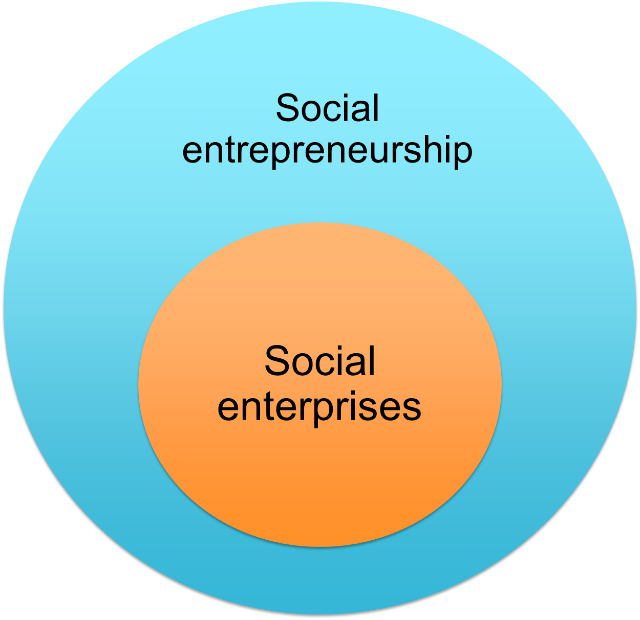
Definition of Social Entrepreneurship (SE)
within STEPUp
SE is the process of applying innovative business models to address social problems (for people and communities) by achieving both profit and purpose. SE creates long-term value and generates sustainable impact for society and the connected ecosystem.
08

Slide 9
Definition of social enterprises
A business (at least 50% of the income is business based) with primarily social objectives, whose profits are principally reinvested for the purpose of the business or the community (UK law)
Business organizations that play the role of change agents in the social sector by adopting a mission to create and sustain social value pursuing new opportunities and engaging in a process of continuous innovation (Dees, 2007)
A business organization or venture that advances its social mission through entrepreneurial earned income strategies (Emerson, 2006)
A multiple-goal, multi-stakeholder and multiple-resource enterprises that rely on collective dynamics and bear economic risk related to their activity (Defourny and Nyssen, 2010)
09
Notes:
Social enterprises are a specific type of organizations, which pursue social goals while carrying out a significant amount of economic, market-based activity. In other words, social enterprises use business tools to introduce social change and improvements in regard to social problems.
Because definitions of SE have been developed in different domains (non-profit, for-profit and public sectors) they are not all the same, however, remain fairly similar. Below you can find some examples of popular definitions of social enterprise.

Slide 10
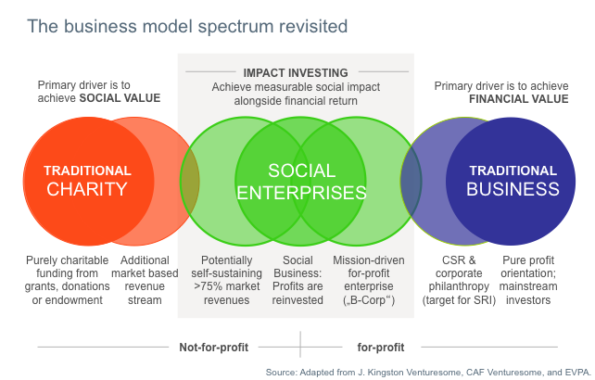
Delineation of social enterprises
10

Slide 11
Characteristic features of social enterprises
A clear social mission
Hybrid organizations; combining social and economic goals, social and market logic
Own economic activity and revenue generation
Community based and community oriented
Relying on cooperation and networks
Innovative
Implementing social change
Various legal forms (depending on country)
11

Slide 12
What is your experience with social enterprises?
How long have social enterprises been in the interest of academia, public policy, general public?
How would an average citizen in your country describe what are SEs?
Are SEs popular (among customers, potential employees or partners, as career path)?
What is the most common legal form that SEs function in?
Do they receive government support?
Concepts and contexts of social enterprises
Work in teams
20 mins
12

Slide 13
Sharing session
13

Slide 14
Work from bed (Poland)
Case presentation
Source: https://lezeipracuje.pl/en/
14

Slide 15
Working in teams on a specific SE challenge
15

Slide 16
Wrap up discussion
16

Slide 17
17

