Slide 1
Erasmus+ Capacity Building in Higher Education
Strengthening innovative social
entrepreneurship practices for disruptive business settings in Thailand and Myanmar
Projectref.: 609711-EPP-1-2019-1-AT-EPPKA2-CBHE-JP
Duration: 36 Months (15/01/2020-14/01/2023)

Slide 2
Agenda
02
Notes:
Co znajduje się w tym szkoleniu

Slide 3
Today’s agenda
DAY 2
8:00 (EU) | 12:30 (MMR) | 13:00 (THA) | Introduction to the day
8:15 (EU) | 12:45 (MMR) | 13:15 (THA) | Identifying and mapping social problems
9:00 (EU) | 13:30 (MMR) | 14:00 (THA) | Sharing session
9:40 (EU) | 14:10 (MMR) | 14:40 (THA) | Break
10:00 (EU) | 14:30 (MMR) | 15:00 (THA) | Presentation of local case
11:00 (EU) | 15:30 (MMR) | 16:00 (THA) | Break
11:15 (EU) | 15:45 (MMR) | 16:15 (THA) | Working in teams on a specific SE challenge
12:00 (EU) | 16:30 (MMR) | 17:00 (THA) | Wrap up session
03
Notes:
Co znajduje się w tym szkoleniu

Slide 4
Introduction to group activity
04

Slide 5
Mapping social problems
The understanding of social problems differs
among cultures and in time
Global economy results in global problems with different consequences for different groups of people
“A social problem is any condition or behaviour that has negative consequences for large numbers of people and that is generally recognized as a condition or behaviour that needs to be addressed”
05
Notes:
In the era of modern technology and prosperity, people around the world still face great social and ecological problems such as: poverty, unemployment, illiteracy, violence, homelessness, wars, spread of infectious diseases, pollution, climate change and many others. Social reactions to these problems may be addressed in many ways, such as petitions to the government, social movements or self-help activities, but the most valuable is the work at the base – social entrepreneurship.
Social enterprises are business driven by social goals, which not only create sustainable social added value, but also earn money to be self-efficient. We can observe growing interest in social entrepreneurship, because people are able to use simple tools and processes to change lives of whole communities. Through implementing creative solutions and systemic solutions, they break social patterns for different underprivileged social groups.

Slide 6
Framework
SOCIAL CHANGE
SOCIAL INNOVATION
SOCIAL ENTREPRENEURSHIP
SOCIAL WORK
SOCIAL / HUMAN DEVELOPMENT
SOCIAL EQUITY
SOCIAL WELFARE
SOCIAL POLICY
condition
behaviour
negative consequences
large numbers of people
generally recognized
needs to be addressed
06
Notes:
In the era of modern technology and prosperity, people around the world still face great social and ecological problems such as: poverty, unemployment, illiteracy, violence, homelessness, wars, spread of infectious diseases, pollution, climate change and many others. Social reactions to these problems may be addressed in many ways, such as petitions to the government, social movements or self-help activities, but the most valuable is the work at the base – social entrepreneurship.
Social enterprises are business driven by social goals, which not only create sustainable social added value, but also earn money to be self-efficient. We can observe growing interest in social entrepreneurship, because people are able to use simple tools and processes to change lives of whole communities. Through implementing creative solutions and systemic solutions, they break social patterns for different underprivileged social groups.

Slide 7
Cafeteria of Social Problems
Unemployment among ex-convicts
Illiteracy
Homelessness
Lack of education
Senior unemployment
Domestic violence
Social exclusion of people with disabilities
Teenage pregnancy
Racial discrimination
Drug addiction
Indigenous people rights
Disempowered communities
Women empowerment
07

Slide 8
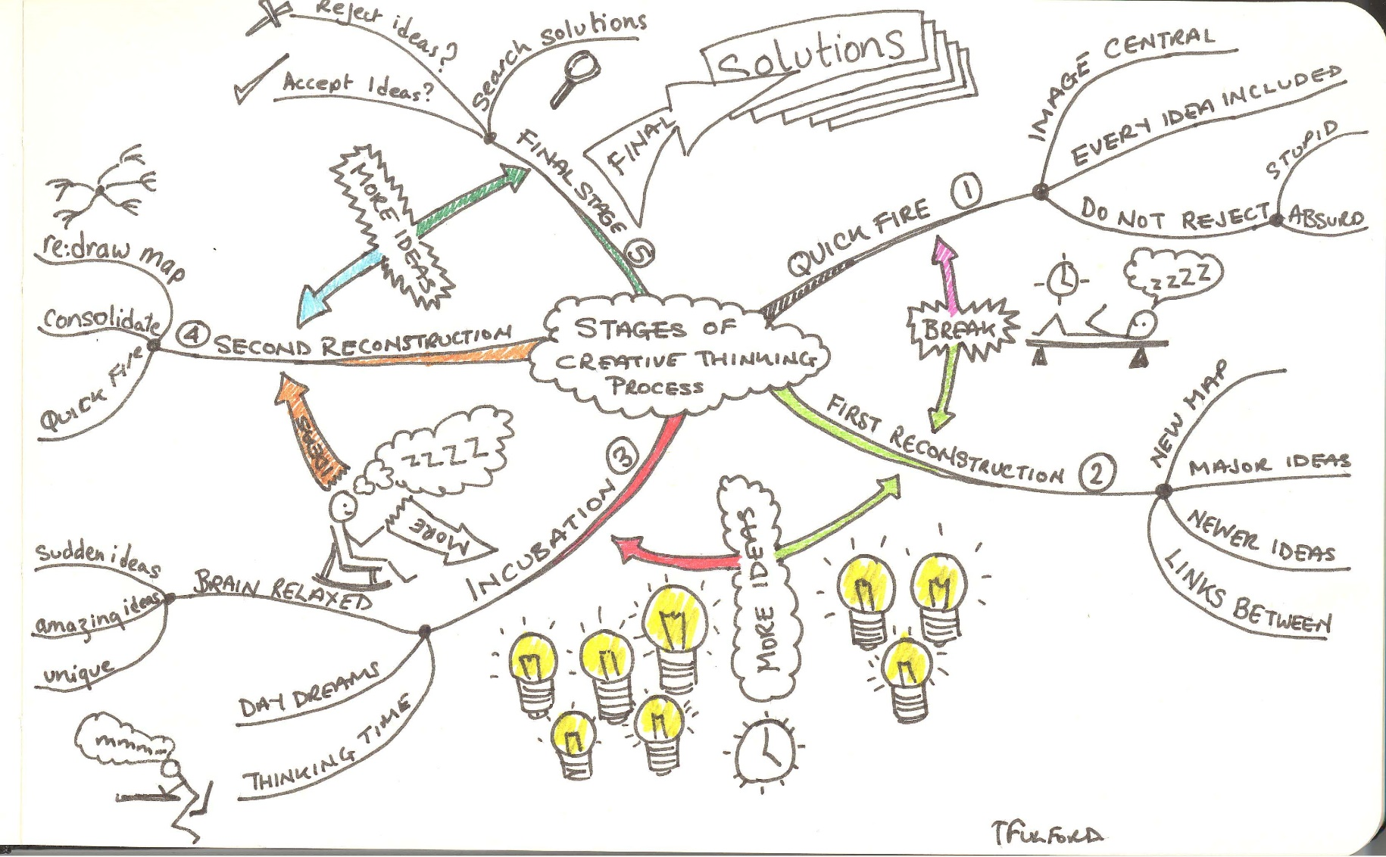
Identifying and mapping social problems
08

Slide 9
Please choose a social problem that your team will map using the provided worksheet
45 mins
Mapping social problems
09

Slide 10
Sharing session
One team member per team presents
the teamwork outcomes
10

Slide 11
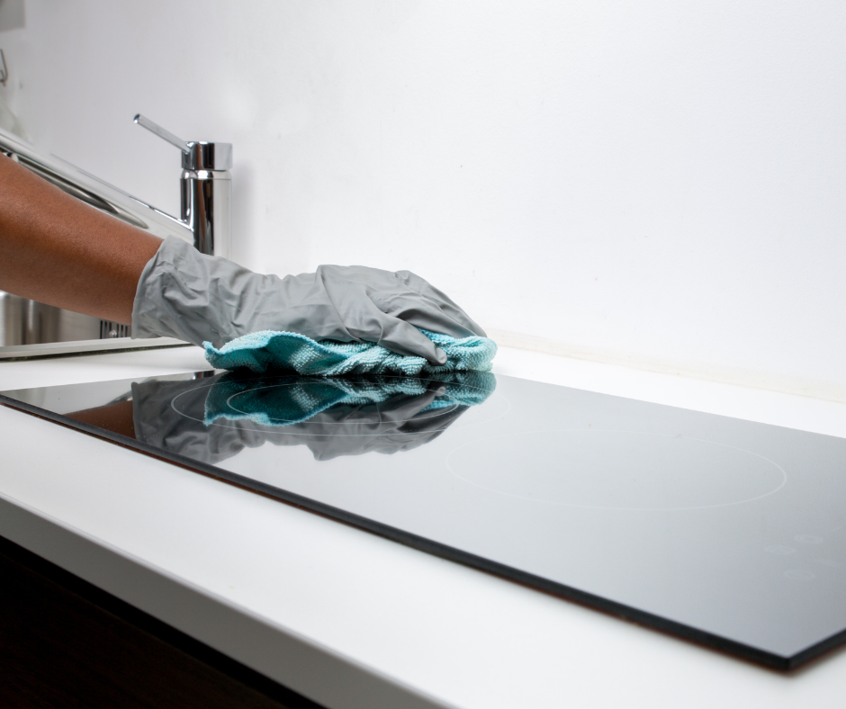
Bliss clean + care company (Thailand)
Presentation of local case
11
Source: https://www.facebook.com/blisscleanandcare/?ref=page_internal

Slide 12
Working in teams on a specific SE challenge
12

Slide 13
Wrap up session
13

Slide 14
14

