Slide 1
Erasmus+ Capacity Building in Higher Education
Strengthening innovative social
entrepreneurship practices for disruptive business settings in Thailand and Myanmar
Projectref.: 609711-EPP-1-2019-1-AT-EPPKA2-CBHE-JP
Duration: 36 Months (15/01/2020-14/01/2023)

Slide 2
Agenda
02
Notes:
Co znajduje się w tym szkoleniu

Slide 3
Agenda
DAY 3
8:00 (EU) | 12:30 (MMR) | 13:00 (THA) | Introduction to SE logic
8:15 (EU) | 12:45 (MMR) | 13:15 (THA) | Delancey Street Foundation
8:35 (EU) | 13:05 (MMR) | 13:35 (THA) | Introduction to canvas
8:55 (EU) | 13:25 (MMR) | 13:55 (THA) | Break
9:10 (EU) | 13:40 (MMR) | 14:10 (THA) | Introduction to activity
9:15 (EU) | 13:45 (MMR) | 14:15 (THA) | Identifying target beneficiaries
9:35 (EU) | 14:05 (MMR) | 14:35 (THA) | Introduction to activity
9:40 (EU) | 14:10 (MMR) | 14:40 (THA) | Identifying and mapping commercial customer segments
10:00 (EU) | 14:30 (MMR) | 15:00 (THA) | Introduction to activity
10:05 (EU) | 14:35 (MMR) | 15:05 (THA) | Working with canvas
10:35 (EU) | 15:05 (MMR) | 15:35 (THA) | Break
10:45 (EU) | 15:15 (MMR) | 15:45 (THA) | Sharing session
11:45 (EU) | 16:15 (MMR) | 16:45 (THA) | Wrap up session
03
Notes:
Co znajduje się w tym szkoleniu

Slide 4
Introduction to SE logic
04

Slide 5
Social mission
Income generation
Social mission as constraint?
Challenges:
limited profit distribution
untrained employees
cannot provide competitive financial compensation to its employees
limited financial resources
lack of dedicated legal form
social and cultural misconceptions conflicting stakeholder interests.
Social enterprises oftentimes must achieve more with less
05

Slide 6
A clear and powerful mission, shared by all members visible in everyday operations and proven by social change generated, can be the key to attracting dedicated talented employees, volunteers, partners and commercial clients
Social mission as opportunity!
Social mission
Income generation
The social mission can be the source of competitive advantage
06

Slide 7
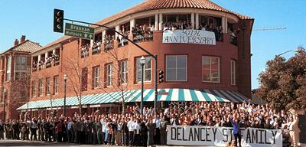
Example of employing the social mission as source of competitive advantage
07

Slide 8
What social problem did Mimi Silbert identify?
What was her social mission?
What strenghths do her target beneficiaries posses?
How did she identify her business opportunity?
What is the current source of the competitive advantage of Delancey Street?
07

Slide 9
CORE ACTIVITIES
COMMERCIAL
SOCIAL
09

Slide 10
Introduction to Canvas
10

Slide 11
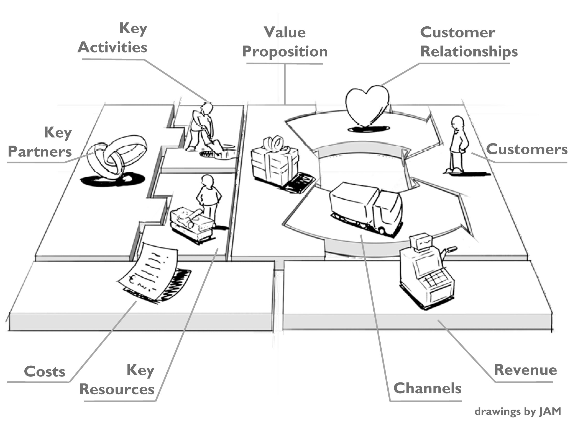
Introduction to Business Model Canvas
11

Slide 12
Definition of a business model
Chesbrough and Rosenbloom (2002) - The business model is “the heuristic logic that connects technical potential with the realization of economic value” (p. 529)
Teece (2010) - “A business model articulates the logic, the data and other evidence that support a value proposition for the customer, and a viable structure of revenues and costs for the enterprise delivering that value” (p. 179)
A business model describes
how an idea will create value.
12

Slide 13
Concept of Business Model Canvas
The Business Model Canvas was proposed by Alexander Osterwalder and Yves Pigneur based on the book: „Business Model Generation: A Handbook for Visionaries” (2010).
Business Model Canvas:
a strategic management and lean startup template for developing new or documenting existing business models.
a visual chart with elements describing a firm's or product's value proposition, infrastructure, customers, and finances.
13

Slide 14
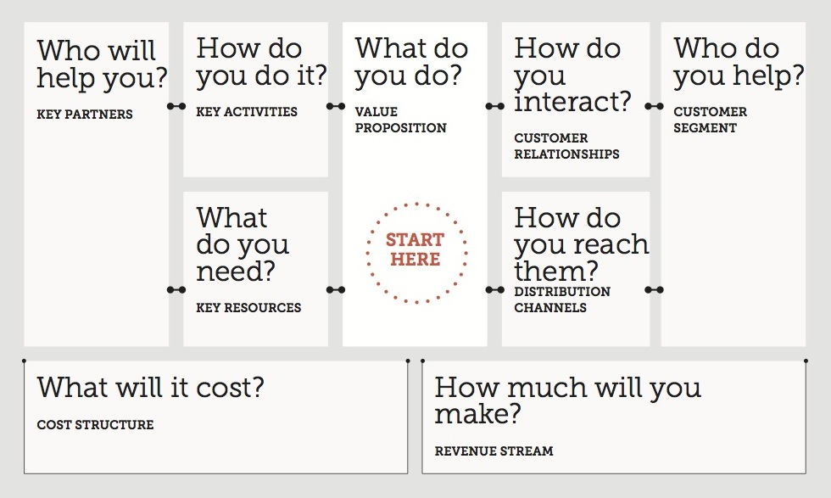
Key elements of the Business Model Canvas
14

Slide 15
Conclusion
Business model canvas:
helps to build businesses by visualization of the most important dimensions
assists firms in improving their products and services
The structure of the business model canvas
can be used to develop any idea...
…even if you are not planning on turning your idea into a business.
15

Slide 16
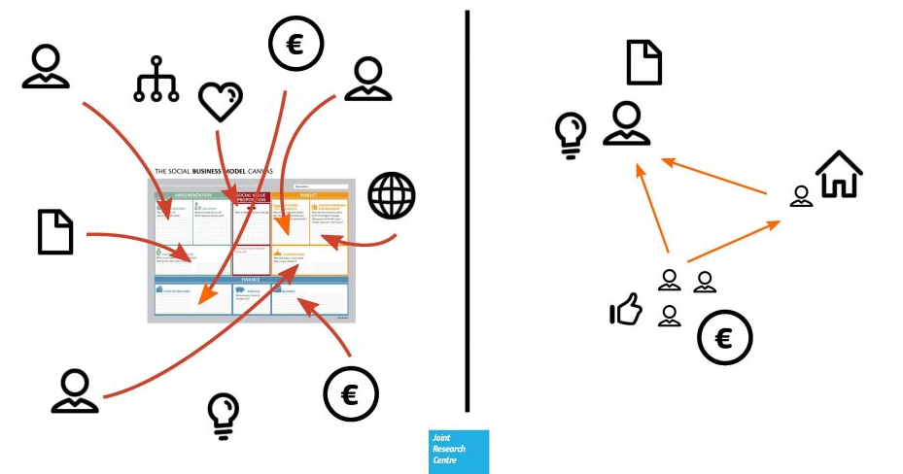
Social Business Model Canvas
15

Slide 17
Social Business Model Canvas – Customer Pesrpective
Customer Segments | Macro-economic Environment | Value Proposition | Product / Service | Logistics / Getting to the Market
 | Competitors |  |  | Marketing & Communication
Cost Structure | Revenue Streams
16

Slide 18
Social Business Model Canvas – Beneficiary Perspective
Social Challenge | Beneficiaries | Resources |  | Partners | Social Challenge / Impact
 | Involvement of Beneficiaries
Desired Future State / Outputs |  |  | Core Activities
18

Slide 19
Business Model Canvas (by Alex Osterwalder), https://strategyzer.com/
The 20 Minute Business Plan: Business Model Canvas Made Easy, https://www.alexandercowan.com/business-model-canvas-templates/#Step_7_of_10_Key_Resources
How to choose proper Business Model for Social Enterprise, http://socialinnovation.lv/wp-content/uploads/2015/07/Business-model-webam-small.pdf
Social Business Model Canvas - The tool for social entrepreneurs, http://www.socialbusinessmodelcanvas.com/
Social business models canvas,
How to Master the Business Model Canvas for Social Entrepreneurs, https://www.tbd.community/en/a/business-model-canvas-social-entrepreneurs
Understanding the Business Model of Social Enterprise. A Case Study of Indonesia Mengajar, http://www.diva-portal.org/smash/get/diva2:782135/FULLTEXT01.pdf
Take Your Social Enterprise To The Peak of Success By Challenging The Business Model Canvas, http://socialenablers.co/challenging-the-business-model-canvas/
19

Slide 20
Identifying target beneficiaries
20

Slide 21
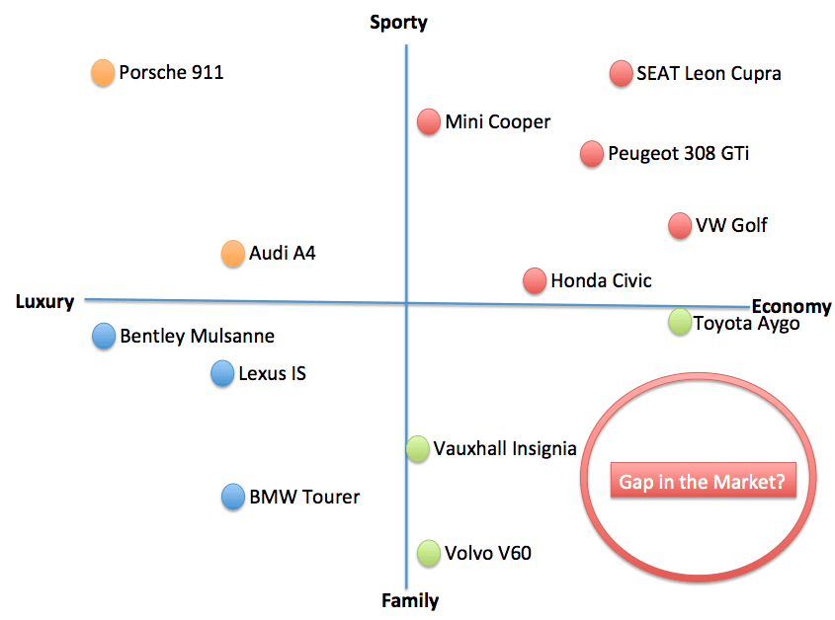
Identifying and mapping commercial customer segments
21

Slide 22
Sharing session
22

Slide 23
Wrap up session
23

Slide 24
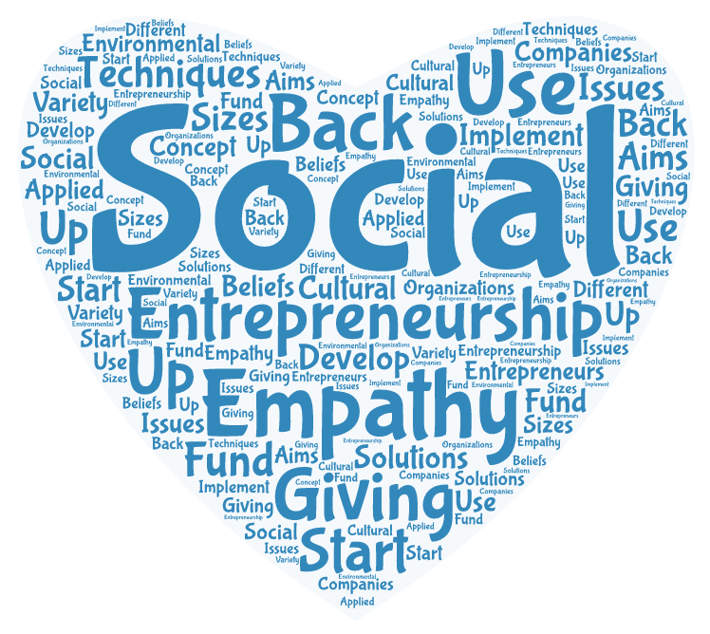
24

