Slide 1


Erasmus+ Capacity Building in Higher Education
Strengthening innovative social
entrepreneurship practices for disruptive business settings in Thailand and Myanmar
Projectref.: 609711-EPP-1-2019-1-AT-EPPKA2-CBHE-JP
Duration: 36 Months (15/01/2020-14/01/2023)
November 16 -18, 2020

Slide 2
Are you ready to be change-maker?
ต้อนรับอย่างอบอุ่น
ကြိုဆိုပါတယ်
Serdeczne powitanie
warm welkom
Herzlich Willkommen
Notes:
Are you ready to be a change-maker?
A warm welcome to our second STEPup Training. For those who don’t know me yet, my name is Birgit. I’m from FH Joanneum in Graz, Austria and one the one hand I’m responsible for the second training and on the other hand I’m also in the role as the project-leader.
However, a project can never succeed without the support and commitment of a great team. I have to say, that this project team is really fantastic, reliable, committed and just fun to work with. Because of this commitment I hope you can see & feel our team spirit in this project.
Before I move on I would like to give the opportunity to some of my colleagues that you know who are you dealing with and whom you are going to meet throughout the trainings. Let’s start with Monika, from Poland, she is in the lead of the entire knowledge transfer, meaning training sessions and multiplier events.
Then Lilya, my colleague from the Netherlands. She is responsible for the third training session.
Lets’s move on with Mike our national coordinator in Thailand.
And Moe Thida our national coordinator in Myanmar.
Last but not least I would like to hand over to Ivana, which will show you today more about the different plattforms.

Slide 3
Main aims of STEPup
To promote disruptive social entrepreneurship practices in selected Thai and Burmese regions by recognizing their needs and transferring best practice approaches from European to the partners in Thailand and Myanmar.
To facilitate innovative social entrepreneurship education by capacity buildings trainings to increase the labour market relevance of social entrepreneurs.
To foster innovation in the field of social entrepreneurship by involving established social entrepreneurs in student-business learning activities within the STEPup Social Entrepreneurship knowledge Hubs.
To enhance the cooperation higher education-enterprise and students learning experience by developing Innovative Social Entrepreneurship Case studies.
To promote greater access to high quality educational materials on the topic of teaching & learning methods and technology enhancement, providing Open Educational Resources to regional and international communities.

Slide 4
THE MAIN TARGET GROUPS OF THE STEPup PROJECT
HEI leaders and managers of the areas business management/development, entrepreneurship and social entrepreneurship
Academic staff focusing on business management/development, entrepreneurship and social entrepreneurship
Students and student associations studying business programmes
Companies working in the field of social entrepreneurship
Business development agencies and political partners
Who do we address?
09

Slide 5
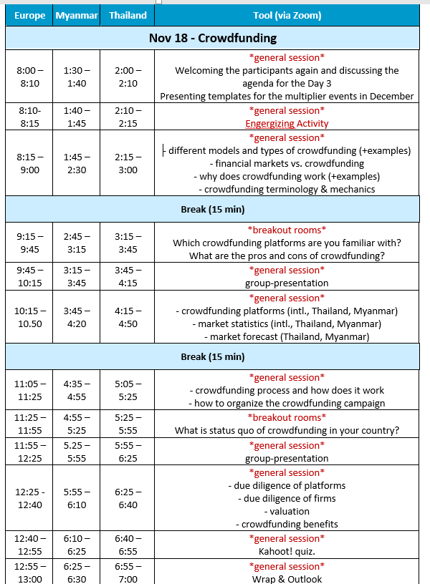
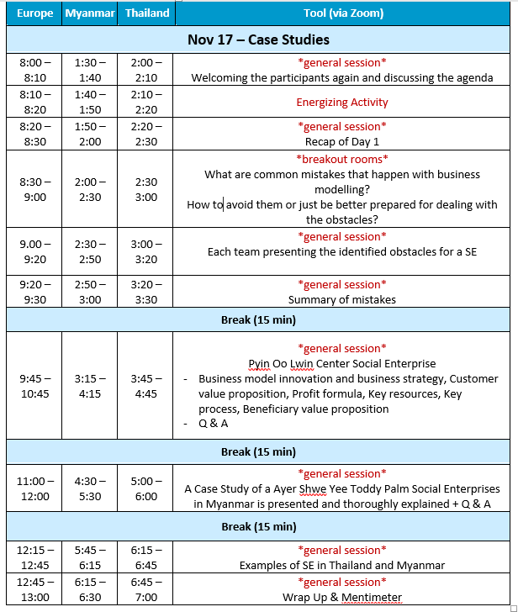
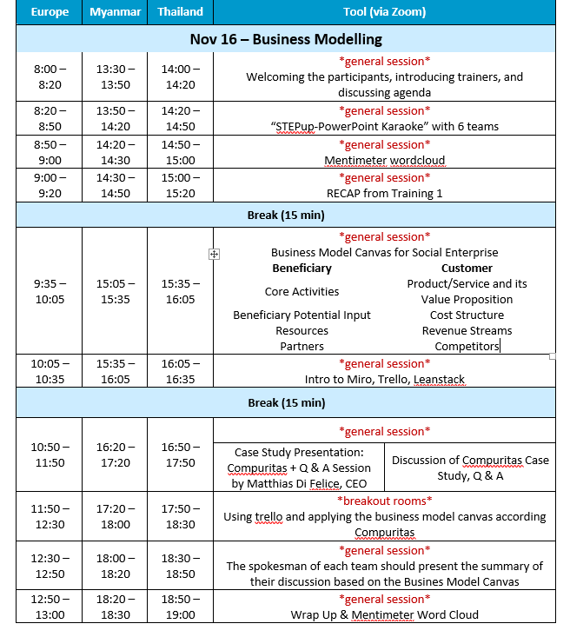
Roadmap
Nov 16, 2020
Business Modelling
Nov 17, 2020
Case Studies
Nov 18, 2020
Crowdfunding
Notes:
What’s our roadmap? I called it a roadmap and not agenda. Because agenda sounds so serious and a roadmap allows more flexibility to take maybe some sideroutes.
Roughly speaking, we have restructured training 2 due to the feedback we received from you from training 1. The main requirement from you was to get to know more examples of Social Entrepreneurs. Therefore we are focusing today on Business Modelling, tomorrow we are spending quite some time on two case studies. And you will get an overview of Social Enterprises in your countries. Our last day is focused on ‘cowdfunding’, an innovative approach how to receive fundings which many start-ups need at the beginning.
How does it look like in detail?
Lock Down in Austria, Matthias might be effected.
Tuesday, we are starting with a short energizer. We will allow us some time to think about some obstacles why SE fail, and what can be done to avoid it. Then we welcome our first guestspeaker of the day. And we will have a closer look at the Ayer Shwe Yee Toddy Palm Social Enterprise.
After a short break you will receive information about other SE in Thailand and Myanmar. We will close our second day with a short Mentimeter question.
Before we are jumping to our core topic of Crowdfunding on Wednesday, we will show you the templates that you should use for your multiplier events. I think crowdfunding is a very interesting approach to collect money. Therefore I’m very happy that my colleague Michael, The head from the Institute of Banking & Insurance, will give you insights into this broad topic.
Are there any questions?

Slide 6

Team – EU-partners
Team – Payap University
Team – Burapha University
POWERPOINT KARAOKE
Team – Prince of Songkla University
Team – Mahasarakham University
Team – Mandalay University
Team – NMDC

Slide 7
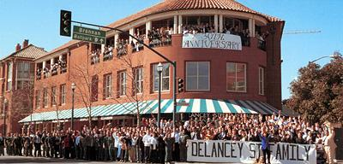

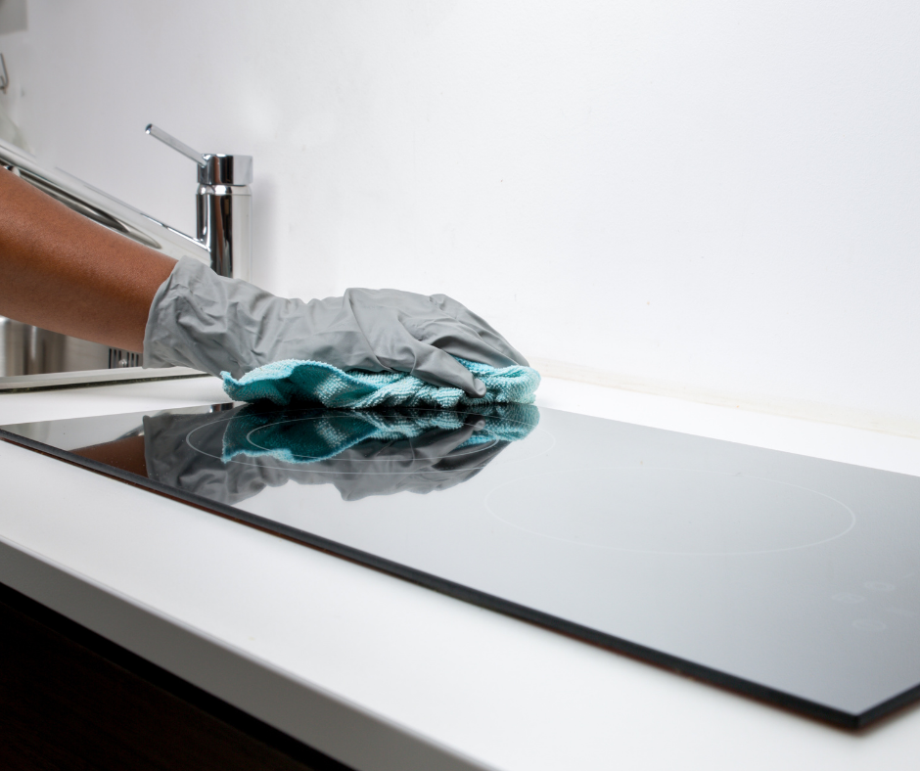
Recap
What can you remember from training 1?
Concepts of social enterprises
Case studies:
  Deelancy Street
  Work from Bed
  Bliss Clean & Care Company
Identifying and mapping social problems
Identifying and mapping business opportunities
Introduction to canvas
Identifying target beeneficiaries
Identifying and mapping commercial customer segments
Notes:
What can you remember from the three case studies?
Deelancy street: to provide a structured educational and living environment in which men and women, most of whom are ex-felons and substance abusers, can learn the skills they need to rebuild their lives.
Work from Bed: is the first Polish marketing agency that has been established to provide opportunity for people with mobility disabilities. People are usually isolated in Poland and therefore difficult for them to find a proper job.
Bliss Clean & Care Company: Provide a variety of cleaning and housekeeping services for homes, apartments and condos. To employ and empower local women through job skill training and employment opportunity eliciting dignity + respect.

Slide 8
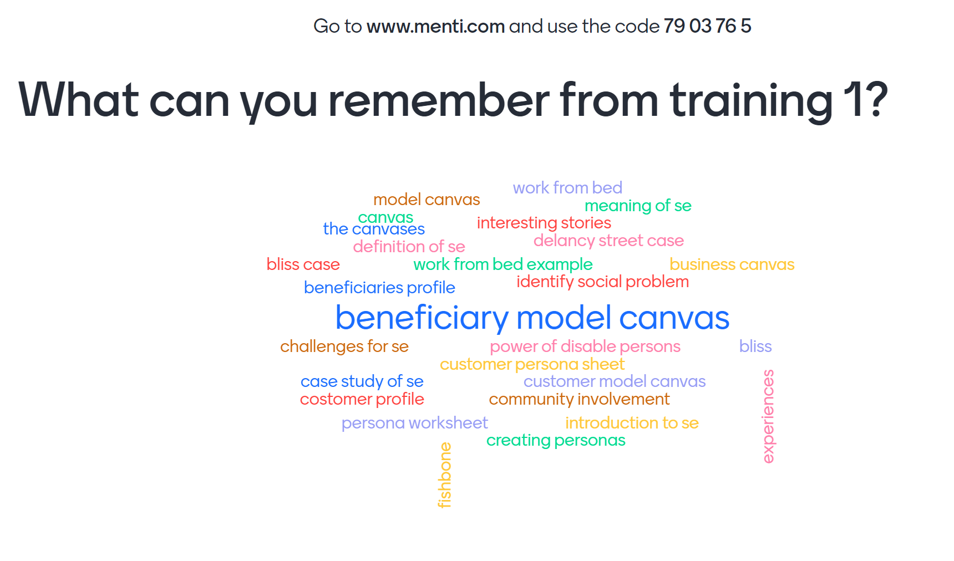

Slide 9
Definition of Social Entrepreneurship (SE) within STEPup
SE is the process of applying innovative business models to address social problems (for people and communities) by achieving both profit and purpose. SE creates long-term value and generates sustainable impact for society and the connected ecosystem.
Notes:
Social enterprises are a specific type of organizations, which pursue social goals while carrying out a significant amount of economic, market-based activity. In other words, social enterprises use business tools to introduce social change and improvements in regard to social problems.
Because definitions of SE have been developed in different domains (non-profit, for-profit and public sectors) they are not all the same, however, remain fairly similar. The definition we are working with within this project is as you can read here:

Slide 10

Characteristic features of social enterprises
A clear social mission
Hybrid organizations; combining social and economic goals, social and market logic
Own economic activity and revenue generation
Community based and community oriented
Relying on cooperation and networks
Innovative
Implementing social change
Various legal forms (depending on country)

Slide 11
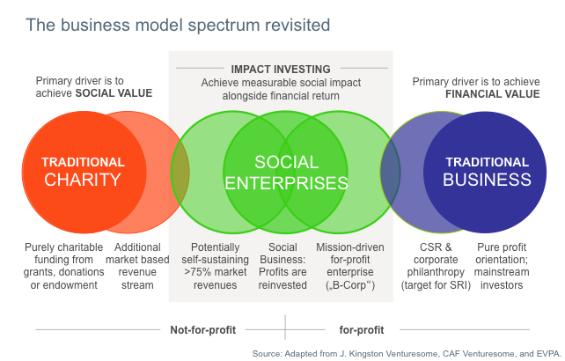
Delineation of social enterprises
Source. Adapted from J. Kingston, CAF Venturesome, and EVPA

Slide 12
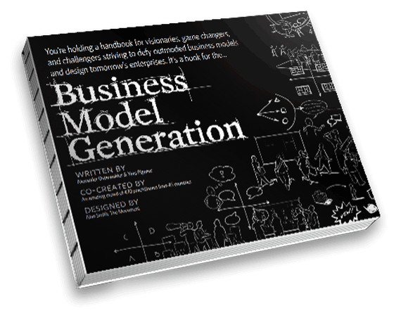
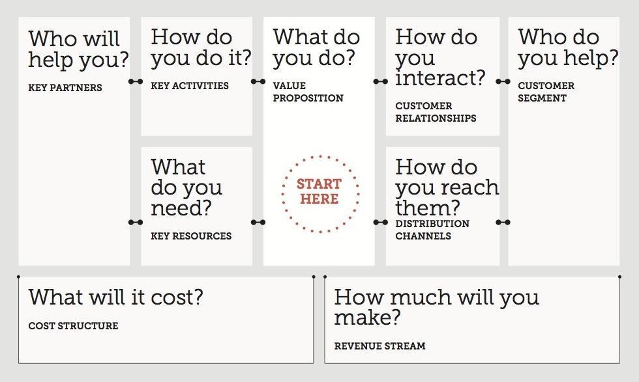
Introduction to Business Model Canvas
“A business model can be described with 9 basic building blocks”
Osterwalder, A. & Pigneur, Y. (2010): Business Model Generation, John Wiley & Sons, Inc.
Free Preview:
https://www.strategyzer.com/books/business-model-generation
Notes:
The Business Model Canvas was proposed by Alexander Osterwalder and Yves Pigneur based on the book: „Business Model Generation: A Handbook for Visionaries” (2010).
Business Model Canvas:
a strategic management and lean startup template for developing new or documenting existing business models.
a visual chart with elements describing a firm's or product's value proposition, infrastructure, customers, and finances.
Business model canvas:
helps to build businesses by visualization of the most important dimensions
assists firms in improving their products and services
The structure of the business model canvas can be used to develop any idea even if you are not planning on turning your idea into a business.

Slide 13
Recap
<
EFFICIENCY / COSTS
VALUE CREATION

Slide 14


Social Business Canvas
Marketing & Communication | Distribution | Product / Service and its Value Proposition |  | Competitors | Customer Segments
Cost Structure |  |  | Revenue Streams
ü
Training 3
Customer Perspective
Notes:
But what is different to a Social Enterprise? One main difference is, that within the social enterprise ecosystem you have the beneficiaries and the customers who are using the services that social business provide. Customers are those who pay for a goods or services while the beneficiaries are those whom the Social Enterprise wants to help. Therefore we need for our business canvas not only 9 building blocks from the customer perspective, but also building blocks from the beneficiary perspective. Whenever I’m talking about on or from the customer perspective I’m using the green hood. when I’m talking about the beneficiary perspective, I’ll wear the blue hood.
The checkmark indicates what we have covered in our first training while the exclamation mark is indicating which building block we are covering today in our second training.
Here you see the Social Business Canvas from the Customer Perspective. Therefore I have to switch now to the green hood.
According to the slide we have covered the customer segments already in October, but will have a look on Distribution, products/service and it’s value proposition, competitors, cost structure and revenue streams today.

Slide 15



Social Business Canvas
Social Challenge | Beneficiaries | Beneficiaries Potential Input | Partners
 | Core Activities
Resources |  | Desired Future State / Outputs
ü
ü
Beneficiary Perspective
Training 3
Notes:
Now lets have a look on the beneficiary perspective. This means I have to switch to the blue hood.
According to that, the two building blocks. Social Challenge and Beneficiaries were covered in October, while the beneficiaries potential input, partners, core activities and resources will be covered today. The desired Future State / Output will be covered in the next training. This means if you are interested to get the full picture, please register also for the third training ☺.
As you notice quite a lot of content. That you have enough energy for the building blocks we are discussin I suggest to have a break for 15 minutes. Let’s be back at…..

Slide 16
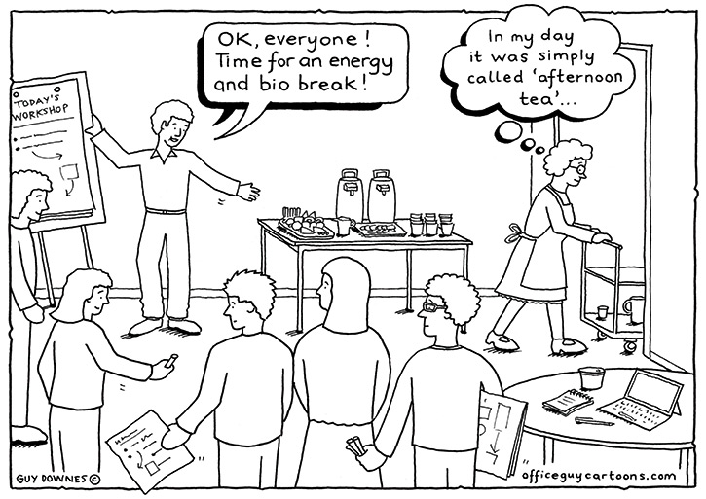

Slide 17

Social Business Canvas
Marketing & Communication | Distribution | Product / Service and its Value Proposition |  | Competitors | Customer Segments
Cost Structure |  |  | Revenue Streams
ü
Training 3
Customer Perspective
Notes:
1.) Customer Segments you want to serve
2.) Value Proposition
The Value Proposition Building blocks describes the bundle of products and services that create value for a specific customer segment. The Value proposition is the reason why customers turn to one company over another. Each Value Propositions consists of a selected bundle of products and/or services that caters to the requirements of a specific Customer segment . In this sense the Value Proposition is an aggregation, or bundle of benefits that a SE offers customers.
Some Value Proposition might be innovative and represent a new or disruptive offer. Others may be similar to existing market offers, but with added features and attributes.
3.) Distribution
The Distribution Building Blocks describe how a SE communicates with and reaches its Customer Segments to deliver a value proposition.
Communication, distribution, and sales channels comprise a company's interface with customers. These distribution channels are customer touch points that play an important role in the customer experience. Key question here is: through which Distribution channels to our customer segments want to be reached?
4.) Marketing & Communication
The Marketing & Communication Building Block describes the types of relationships a SE establishes with specific customer segments.
A SE should clarify the type of communication it wants to establish which each Customer segments. Relationships can range from personal to automated.
Marketing and Communication can be driven by:
Customer acquisition
Customer retention
Boosting sales (upselling)
Key question here is: What type of relationship does each of our customer Segments expect us to establish and maintain with them? Hoy costly are they?
5.) Cost Structure
The Cost structure describes all costs incurred to operate a business model. Here you should describe the most important costs incurred while operating under a particular business model. Creating and delivering value, maintaining customer relationships, and generating revenues all incur costs. Such costs can be calculated relatively easily after you have defined Key Resources, Key Activities and Key Marketing & Communication Strategies. Some business models are more cost-driven than others.
6.) Revenue Streams
As the building block implies, here you think about how much cash do you generate from each customer segment? Of course you know, that you have to subtract the costs from the revenues to create finally some earnings.
If customers comprise the heart of a business model, revenue streams are its arteries. You as a SE must ask yourself ‘For what value is each Customer Segment truly willing to pay?’ . Each revenue stream may have different pricing mechanism, such as fixed list prices, bargaining, auctioning, market dependent, volume dependent, or yield management.
7.) Competitors
Finally you have to figure out what are the competitors doing? Do they target the same customer segment, do they offer the same product/Service. How do we differentiate with our value proposition to our competitor?

Slide 18
Product / Service and its Value Proposition
What are the features of your product & service?
What is the core of your product / service?
Of what elements does your product / service consist of?
In how far is your product / service innovative?
…
Customer Perspective
Notes:
A Value Proposition creates value for a Customer Segment through a distinct mix of elements catering to that segment’s needs. Values may be quantitative (eg. price,, speed of service,..) or qualitative (eg. Design, customer experience, ..)-
The key questions we are asking here are:
What value do we deliver to the customer?
Which one of our customer’s problems are we helping to solve?
Which customer needs are we satisfying?
What bundles of products and services are we offering to each customer segment?
Elements form the following non-exhaustive list can contribute to customer value creation.
Newness
Performance
Customization
Design
Brand/ Status
Price
Getting the job done
Cost reduction
Risk reduction
Accessibility
Convenience/usability

Slide 19
Distribution
What resources will you need?
Through which channels will your customers want to be reached?
Who will be your strategic logistic partners?
….
Customer Perspective
Notes:
Finding the right mix of distribution channel to satisfy how customers want to be reached is crucial in bringing a value proposition to the market. A Social Entrepreneur can choose between reaching its customer through its own channels, through partner channels, or through a mix of both. Here you should also think about the different channel phases: a.) awareness, b.) evaluation c.) purchase d.) delivery, e.) after sales

Slide 20
Cost Structure
What are the major cost drivers?
What your major value-drivers?
Cost structures can have the following characteristics:
  Fixed costs
  Variable costs
  Economies of scale
  Economies of Scope
Customer Perspective
Notes:
Of course, costs should be minimized in every business model. But low cost structures are more important to some business models than to others. Therefore it can be useful to distinguish between two broad classes of business models cost-structures:
a.) cost-driven business models, which focus on minimizing costs wherever possible. This approach aims at creating and maintain the leanest possible cost structure, using low price value propositions maximum automation, and extensive outsourcing.
b.) Value driven business models focus value creation. For example Premium Value proposition and a high degree of personalized service usually characterize value-driven business models.
Cost structures can have the following characteristics:
Fixed costs: costs that remain the same despite the volume of goods or services produced, eg production companies
Variable costs: costs that vary proportionally with the volume of goods or services produced. Eg music festivals
Economies of scale: cost advantages that a business enjoys as its output expands. Larger companies, for example benefit from lower bulk purchase rates.
Economies of Scope: Cost advantage s that a business enjoys due to a larger scope of operations. In a large company, for example the same marketing activities or distribution channels may support multiple products.

Slide 21
Revenue Streams
For what value are your customers willing to pay?
What are the sources of revenue?
What and how will the customers pay?
Will you offer a donor package?
….
Customer Perspective
Notes:
A business model can involve basically two different types of revenue streams:
1.) transaction revenues resulting from one-time customer payments
2.) Recurring revenues resulting from ongoing payments to either deliver a value proposition to customers or provide post-purchase customer support.
Key questions you should ask yourself:
- For what value are our customers are really willing to pay?
For what do they currently pay?
How are they currently paying?
How would they prefer to pay?
How much does each Revenue Stream contribute to overall revenues?
There are several ways to generate revenue streams:
Asset sale: the most widely understood revenue stream derives from selling ownership rights to a physical product.
Usage fee: by using a particular service
Subscription fee
Lending/renting/leasing
Licensing
Brokerage fees
Advertising
I’m sure you are aware of the different pricing mechanism like Fixed and dynamic pricing strategies. But it would be out of scope to go more in detail here.

Slide 22
Competitors
Who are your direct competitors?
Who are your indirect competitors?
How your competitors fulfill customer needs?
What is your USP (unique selling proposition)?
….
Customer Perspective
Notes:
What's the difference between direct and indirect competitors?
Direct Competitor of Pizza Hut will be another Pizza-Restaurant which is also well known for their variety of Pizzas. Indirect would be Burger Kind, Mac Donald, ….

Slide 23
Core Activities
Beneficiary Perspective
What core activities do our value proposition require?
What core activities are for your beneficiaries?
What core activities do we need to maintain successfully customer relationships?
What core activities do we need for our revenue streams?
Notes:
The questions we are asking here are for example:
What ‘Core Activities’ do our Value Propositions require?
What ‘Core Actvities’ are required for our distribution channels?
What ‘Core Actvities’ are required for our customer relationships?
From which core activities can we generate revenues?
The core activities can be divided basically into three categories:
Production – these activities relate to designing making and delivering a product in substantial quantities and/or of superior quality.
Problem solving: key activities of this type relate to coming up with new solutions to individual customer problems.
Platform/network: business models designed with a platform as a key resource are dominated by platform or network related activities. Like social giver.
What are the core activities of ‘Working from Bed’ and ‘Bliss & Clean Care Company’?

Slide 24
Beneficiaries Potential Input
Beneficiary Perspective
What channels will you use to involve the beneficiaries?
How will you convince them to participate?
What challenges may occur why trying to involve beneficiaries?
Notes:
After you have described and defined the core activities you have to ask yourself how to include the input of the beneficiaries?
How will you convience them to participate?
What challenges may occur when involving the beneficiaries?
How did the Maria ‘Majka’ the owner from ’Working from Bed’ approach these questions? How did Kristi from ‘Bliss & Clean Care Company’ approach these questions?

Slide 25
Partners
Beneficiary Perspective
What social partners do you want to cooperate with?
What business partners will you need?
What institutional partners will you involve?
What know-how will they give you?
How will you build relationships with your partners?
….
Notes:
It can be useful to distinguish between different motivations for creating partnerships:
Optimization and economy of scale: it’s the most basic form of partnership of buyer-supplier relationship. Its aiming to optimize the allocation of resources and activities. It doesn't make sense for company to own all resources or perform every activity by itself.
Reduction of risk & uncertainty: partnerships can help to reduce risk in a competitive environment characterized by uncertainty. It is not unusual for competitors to form a strategic alliance in one area while competing in another.
Acquisition of particular resources and activities. Only a few SE own all resources or perform all activities described by their business models. Rather, they extend their own capabilities by relying on other firms to furnish particular resources or perform certain activities.
Think about Sidekick, a creative & media agency for social change, the company you have seen in the video at the beginning of this training. They are partnering with many organizations The World Bank , Amnesty International, save the children,…
Which partners have you identified for ‘Work from Bed’? Or Bliss & Clean?

Slide 26
Resources
Beneficiary Perspective
What human resources do we need for our value proposition?
What material resources do you need for our value proposition?
What financial resources will you need for our value propositions?
Which know-how will you need?
…
Notes:
Key resources can be physical, financial, intellectual, or human. Key resources can be owned or leased by the company or required from key partners.
The key questions we should are: What resources do our value propositions require? What our distribution channels? Customer relationships? Our beneficiaries? Our revenue streams?
Which resources are needed by ‘Work from Bed? Which resources are needed for ‘Bliss & Clean? Or ‘Look Alike’ ?

Slide 27
Social Business Canvas
Customer Perspective
Marketing & Communication | Distribution | Product/Service and its Value Proposition |  | Competitors | Customer Segments
Cost Structure |  |  | Revenue Streams
What resources will you need?
Through which channels will your customers want to be reached?
Who will be your strategic logistic partners?
….
Who are your direct competitors?
Who are your indirect competitors?
How your competitors fulfill customer needs?
What is your USP (unique selling proposition)?
……
Who are the people who will buy your product / service?
(Age, living in a city/village, family status, sex, education etc.)
Where does he/she get information from?
On what basis do they make purchase decisions?
……
What are the features of your product / service?
What is the core of your product / service?
Of what elements does your product / service consist of?
What do you offer, that is different from other products / services?
…….
What are the major cost drivers? (People, production, distribution, design, materials, technology… etc.)
What are your major value-drivers?
For what value are your customers willing to pay?
What are the sources of revenue?
What and how will the customers pay?
Will you offer a donor package?
…

Slide 28
Social Business Canvas
Beneficiary Perspective
Social Challenge What is the present situation (numbers, scale of problem, geographical area etc.)? What are the root causes of the problem? What are the factors contributing to the problem? Are there any local problem solutions? …… | Beneficiaries Who are your target beneficiaries (age, sex, location, education, work experience, material status, registered in other foundations/social care organizations)? What are their needs? …. | Beneficiaries Potential Input What are your core activities? What core activities are for your beneficiaries? ….. | Partners What social partners do you want to cooperate with? What business partners will you need? What institutional partners will you involve? What know-how will they give you? How will you build relationships with your partners? ….
 | Core Activities What are your core activities? What the core activities are for you beneficiaries? …
Resources What human resources will you need? What material resources will you need? What financial resources will you need? What know-how will you need? …. |  | Desired Future State / Outputs
Training 3

Slide 29



Intro to Miro, Trello & Leanstack

Slide 30


Slide 31

Compuritas
IT with responsibility
Refurbish high quality IT hardware
Covid19-crisis made the digital gap of social imbalance visible
Notes:
IT refurbisher

Slide 32

Compuritas – Social Problem
Due to the fast pace of today’s business world, business hardware devices are used only for 3-5years
With the deletion of date and the refurbishment of the hardware provided it is possible to reduce electric waste
Different target groups have access to decent priced IT hardware, for example for schools, educations associations and clubs
All technical equipment sold by Compuritas has an extended guarantee of 24 months to increase trust
Notes:
Compuritas is basically tackling two social problems connected to today’s society
Due to the fast pace of today’s business world, business hardware devices are used only for 3-5years for tax and economic reasons. Then the hardware business devices are replaced even though they are in perfect condition and fully functioning. Compuritas is then buying the devices from companies or receive them as a sponsorship to refurbish them. With the deletion of date and the refurbishment of the hardware provided it is possible to reduce electric waste on the one hand side.
So, through the social business model of Compuritas electric waste is lowered and different target groups have access to decent priced IT hardware for educational purposes. Further, all technical equipment sold by Compuritas has an extended guarantee of 24 months to increase the trust in refurbished IT hardware and the durability of it.
In addition to what has been presented above it also needs to be mentioned that Compuritas has recognized that the Austrian population, in comparison to the German, is less open to the topic reusable devices and that people are not well informed about grey energy, also known as production energy, and the impact it has on the environment.
This is perceived as a societal problem as Austrians tend to renew their electronics on a regular basis even though they are not broken but because a supposedly “newer and better” product is on the market. This is the result of years of marketing that channeled peoples´ habits over time. But since Compuritas has been in business they have seen slight improvements in the habits and openness of consumers.
for

Slide 33



Compuritas – Founders Profile
Founder: Rüdiger Wezl-Piewald
Founded 2009
Handed over to Matthias Di Felice, CEO
2015: Expansion required investors
Notes:
The company was founded by Rüdiger Wetzl-Piewald in 2009, who in the meantime has handed the company over but he is still in close contact with the current CEO. Rüdiger is now the CEO of the social business club in Graz/Styria/Austria. Through his new role in the social business industry, Rüdiger is still able to help and guide Compuritas on their journey.
The current CEO, Matthias Di Felice, started his journey at Compuritas as a student studying to become a teacher. Matthias originally enjoyed his education in IT at the Higher Technical Institute (HTL) and during his studies, he worked at Compuritas where he and Rüdiger kept on working on the business idea.
Im Dezember 2013 hat Compuritas an der PULS4 Startup Show "2 Minuten 2 Millionen" teilgenommen und prompt den Hauptpreis von € 100.000 Medienkapital gewonnen. Hier nochmals die wichtigsten Momente der Show. Similar ot Dragons Den - is a reality television program format in which entrepreneurs pitch their business ideas to a panel of venture capitalists in the hope of securing investment finance from them.
Given the increase of publicity Compuritas was one of the first companies in Austria to participate in crowdfunding. Through the participation in the show and crowdfunding, Compuritas had the capital to open their first store in Graz.

Slide 34

Compuritas – Social Mission
Rüdiger noticed in Brazil:
the exclusion of children from the digital world
parents were not able to afford access to education through It devices & infrastructure
Situation in Austria:
Austrian companies usually only use the highest quality hardware
characterized by their durability, thus long warranty period and high performance
After 3-5 years, these devices are regularly exchanged and are in principle in perfect working order
Social Mission:
helping schools with low-budget but high quality equipment
Tailor-made solutions
Reduce electronic waste
Notes:
The business idea emerged about after Rüdiger was in Brazil and recognized that a lot of children were excluded from the digital world and in addition they could not afford the access to education which is eased through IT devices and infrastructure. After being back, Rüdiger started his research about the situation in Austria realized that the same problem was also prominent in Austria. In order to minimize this problem Rüdiger started to investigate on the usage journey of business IT hardware devices and what he found out was the basis for the Compuritas business model.
The mission of Compuritas: Austrian companies usually only use the highest quality hardware. These devices are characterized by their durability, thus long warranty period and high performance.
After 3-5 years, these devices are regularly exchanged and are in principle in perfect working order.
This is exactly where Compuritas comes in. Compuritas takes over these high-quality devices from companies, conduct the most extensive tests according to international standards with these devices, delete all data reliably and verifiably and then equip them with the latest software.
Budget shortage in schools and clubs is no secret. New computer equipment is expensive and this often results in insufficient equipment and overworked teaching staff and IT support staff.
Individually adapted offers, tailor-made solutions and good advice characterize the service of Compuritas. A long warranty period on all equipment creates the necessary confidence.
The advantage of refurbished equipment is the quality and performance at a fair price. If a refurbished device is bought, then an enormous amount of resources is saved and the environment can be protected.
The offers/ services of Compuritas include:
Rollout management and certified data destruction - Compuritas takes over the hardware of companies and deletes data reliably and verifiably.
Employee programme for IT devices – Compuritas supports companies in selling hardware to their employees and take over the whole management as well as the data destruction.
Configurable offers - Whether ready to use with pre-installed complete image of the desired software or empty, memory upgrade or SSD hard disks, Compuritas tailors their offers individually to the needs of the target groups.
Large quantities - Compuritas always has large quantities of the same model which allows the target groups such as school to equip their institution in a uniform way to save administrative effort.
Quality guaranteed – Compuritas´ standard offer is to always have a 24-month warranty directly with the company itself. Warranties are also possible for longer periods with additional costs.
Convenient shopping - Convenient shopping on a company´s favourite portal. Compuritas takes care of the rest as they deliver free of charge throughout Austria, once ordered via the Compuritas webshop, the BBG portal or Stifter-helfen.at.

Slide 35

Compuritas – Value Proposition
Life-cycle extension of computer and hardware
Reduce electronic waste
Enable disadvantaged target groups to have access to IT
Notes:
The beneficiaries of Compuritas are their customers as well. On the one side companies selling their hardware devices are customers and beneficiaries given the services offered by Compuritas for this target group. On the other side, educational providers such as schools, clubs and associations and private people are also customer and beneficiaries because the Compuritas refurbished products´ can be purchased up to 70% cheaper than in conventional stores where explicitly new devices are sold. In addition to that, the customers receive first-class service and high-quality refurbished products. This is where the value for the customer base lies.
The value proposition of Compuritas can be seen in the lifecycle extension of computer hardware and therefore reducing electric waste and ensuring access to IT hardware. Generally, the concept is already successful in other countries around the world but in Austria it definitely can be seen as an innovative approach given the limited awareness and acceptance for refurbished products.
The main revenue streams for Compuritas are the sale of the refurbished devises to the different target groups and also the services offered to companies aiming to sell their “outdated” hardware devices. This is the profit part in their social business model that ensures reaching a break-even point at the end of each fiscal year meaning that they are operating on a sustainable business model that enables them to be financially independent.
In addition, Compuritas also tries to acquire grants from various funding sources to increase their business capacities but until now no long-term grants have been acquired. This is because they classify themselves as a social business and not as a socio-economic company which would have its main focus in the employment of people and not on generating profit to have an impact on social problems.
Further, Compuritas cooperates closely with the Ministry of Environment and the environmental education centre in projects where they try to contribute and/or give input on topics like reusable devices. Currently, Compuritas is involved in an initiative of the Ministry of Education which tries to give access to IT hardware to pupils to improve their access to (online) education. This initiative came to live due to the Covid-19 crisis.

Slide 36

Compuritas – Social Impact
Increase the access to education
Raise awareness on the topic of refurbished devices
Social Reporting Standards
Notes:
The impact of Compuritas is social-ecological as the company aims to increase the access to education and to raise awareness on the topic refurbished devices as a new alternative to support the responsible handling with the available resources on the planet.
Compuritas follows the Social Reporting Standards in order to measure/monitor their impact. As these reporting standards are quite extensive, many working hours need to be put into the reporting. Therefore, the depth of the reporting is somehow dependent on the available working hours. Still, measuring/monitoring the impact achieved is important to the company and thus, yearly reports are produced. One indicator that is used to measure their impact, amongst others, are CO₂ values. With this information, they can then calculate how much CO₂ they have reduced with each product or investment. The calculations are all done according to the social reporting standard and are published in an annual report depending on if they have the time and resources to publish that.
In other words, it can be said that each refurbished computer saves on up to 11kg chemicals, 120kg fossil fuels, 750l water and 550kg CO₂ emissions, compared to the production of a new device.

Slide 37

Compuritas – Key Success Factors
2013 - restructuring its legal form
- increased number of services
Key partners
Mistakes
too much emphasis on social & ecological impact and not on a sustainable business
Hiring process
Notes:
In the year of 2013, the company restructured its legal form and increased the number of their services. The company started with a workshop and gradually grew having their own retail store and production facilities. Today, Compuritas exports their products to 3 countries namely to the Czech Republic, Germany and Italy, whereas Italy is in the trial phase at the moment.
Their key partners, given their business model and explained already earlier on, are companies and organisations renewing their IT hardware/devices on a regular basis and on the other hand side, educational organizations such as schools, associations and clubs as well as private people in need of IT equipment with limited financial resources.
One of the mistakes Compuritas made was their approach to the market. In the beginning, they put too much emphasis on their social and ecological impact and not on a sustainable business. They soon learned that B2B marketing is essential for their future success and adapted their approach. They also made mistakes in the hiring process of employees and did not invest wisely in this area. They invested a lot in training and education of several employees but the trained employees never remained in the company for a long time which led to a loss of resources. They have then learned from this mistake and are now employing apprentices which has proven to be a successful strategy so far.
Compuritas contacts potential partners mainly through cold acquisition via phone calls and emails but also events are essential to the company, especially for building up networks and increasing awareness. Given the increase in awareness among the target groups and the quality of services/products offered the reputation of Compuritas is constantly increasing.

Slide 38

Compuritas – Crisis Management
Covid 19 – crisis: helped to strengthen their position in the market
Cooperation with ‘Teach for Austria’ - supplied children who did not have a computer at home
Compuritas was able to do business online during the Lock-Down
Notes:
Generally, it needs to be said that through the Covid-19 crisis and the quickly arising need to close the digital gap to get access to education, Compuritas was able to strengthen their position and increase awareness of the apparent problem among Austrian pupils. Through a cooperation with Teach for Austria Compuritas was able to supply children who did not have a computer at home and therefore could not participate in online lectures. Through this campaign they can fulfill their core idea of reducing the digital gap in Austria.
Further, because of this situation the products of Compuritas were demanded more than ever.
This also enabled the company to continue with their business online and also with the production in their headquarters, certainly with the security measures needed, as the product were demanded in large quantities.

Slide 39

Notes:
Questions?

Slide 40

Let’s trello ☺
BENEFICIARY | Social Challenge | Beneficiaries | BeneficiariesPotential Input | Core Activities | Resources | Partners
CUSTOMER
Customer Segments | Payap University
Product/Service and it’s Value Proposition |  | Burapha University
Distribution |  |  | Prince of Songkla University
Competitors |  |  |  | Mahasarakham University
Cost Structure |  |  |  |  | Mandalay University
Revenue Streams |  |  |  |  |  | National Management Degree College
Notes:
Please open the trello-invitation I have sent you yesterday in the email.
Let‘s show how it looks like
Let‘s be back at…

Slide 41
trello
Notes:
What did you find out?
Whta was your experience with trello?

Slide 42
What the heck did we do today?
What are your key take aways?
Notes:
What did you find out?
What was your experience with trello?

Slide 43
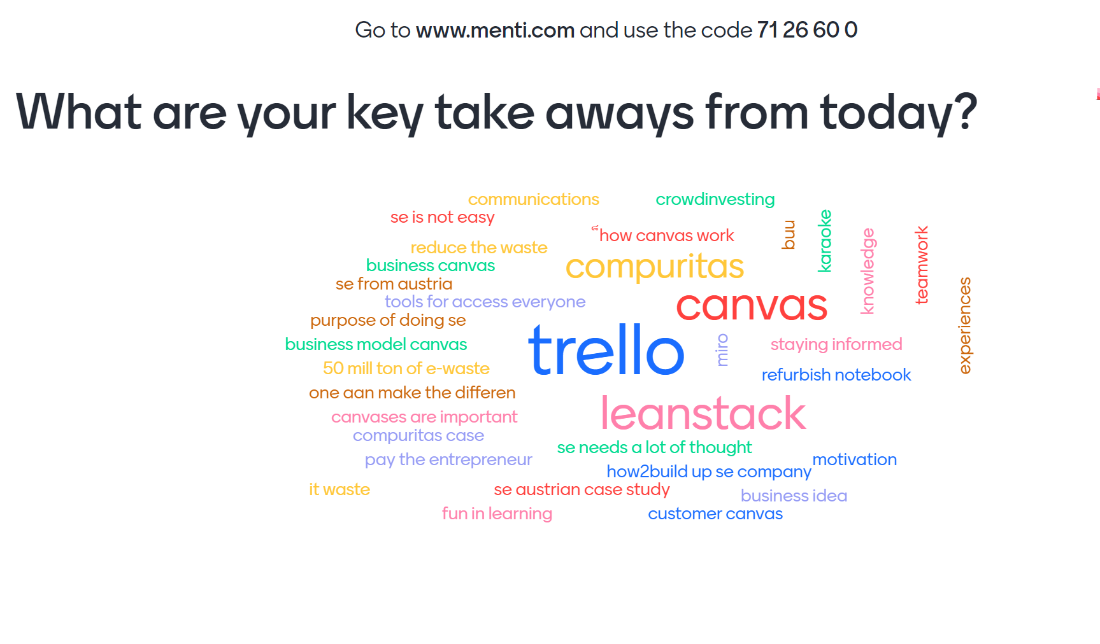

Slide 44
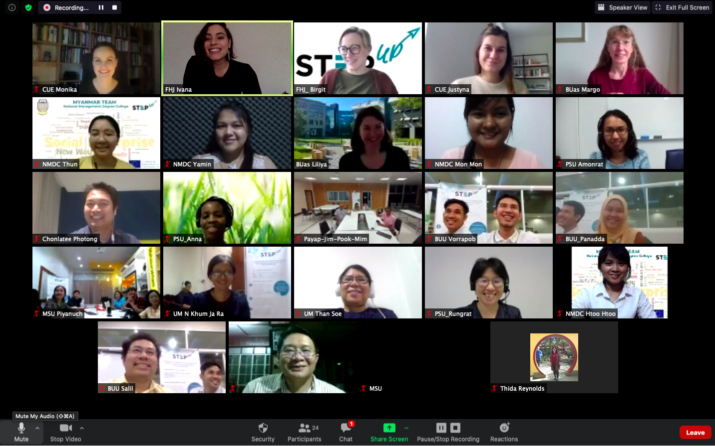

Slide 45
Erasmus+ Capacity Building in Higher Education
Strengthening innovative social
entrepreneurship practices for disruptive business settings in Thailand and Myanmar
Projectref.: 609711-EPP-1-2019-1-AT-EPPKA2-CBHE-JP
Duration: 36 Months (15/01/2020-14/01/2023)

