Slide 1


Erasmus+ Capacity Building in Higher Education
Strengthening innovative social
entrepreneurship practices for disruptive business settings in Thailand and Myanmar
Projectref.: 609711-EPP-1-2019-1-AT-EPPKA2-CBHE-JP
Duration: 36 Months (15/01/2020-14/01/2023)
November 16 -18, 2020

Slide 2
ต้อนรับอย่างอบอุ่น
ကြိုဆိုပါတယ်
Serdeczne powitanie
warm welkom
Herzlich Willkommen

Slide 3
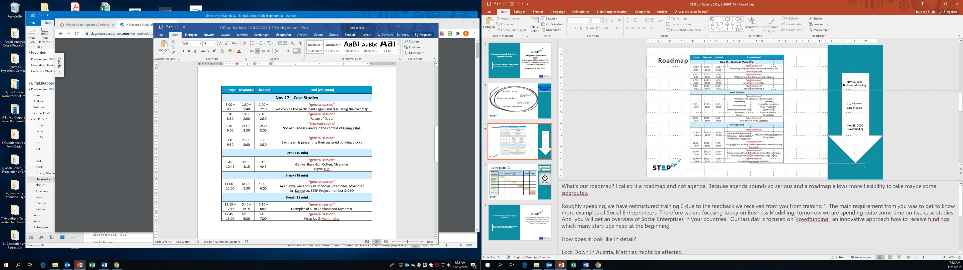
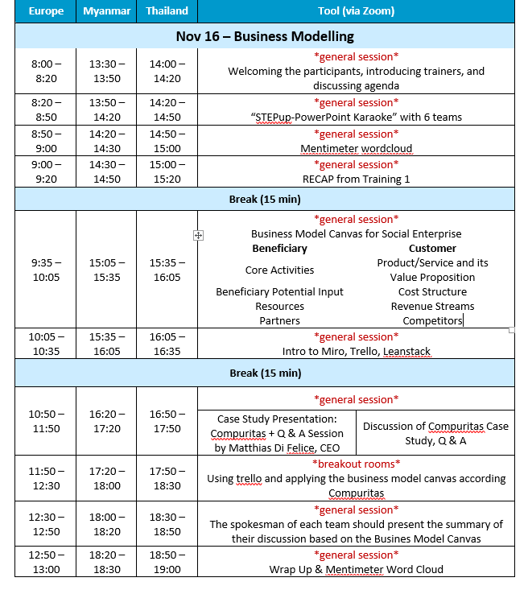
Roadmap
Nov 16, 2020
Business Modelling
Nov 17, 2020
Case Studies
Nov 18, 2020
Crowdfunding

Slide 4

Source: https://teachermarkexpress.com/what-did-you-do-yesterday/

Slide 5
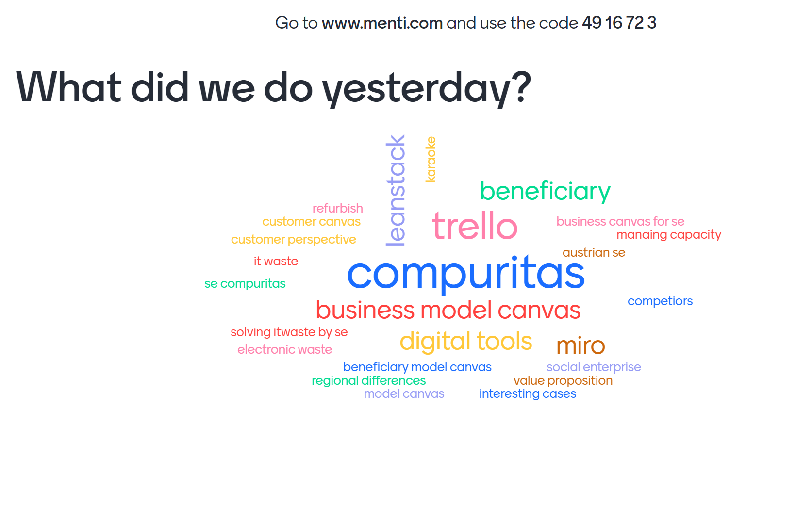

Slide 6


Let’s trello ☺
BENEFICIARY | Social Challenge | Beneficiaries | BeneficiariesPotential Input | Core Activities | Resources | Partners
CUSTOMER
Customer Segments | Payap University
Product/Service and it’s Value Proposition |  | Burapha University
Distribution |  |  | Prince of Songkla University
Competitors |  |  |  | Mahasarakham University
Cost Structure |  |  |  |  | Mandalay University
Revenue Streams |  |  |  |  |  | National Management Degree College

Slide 7
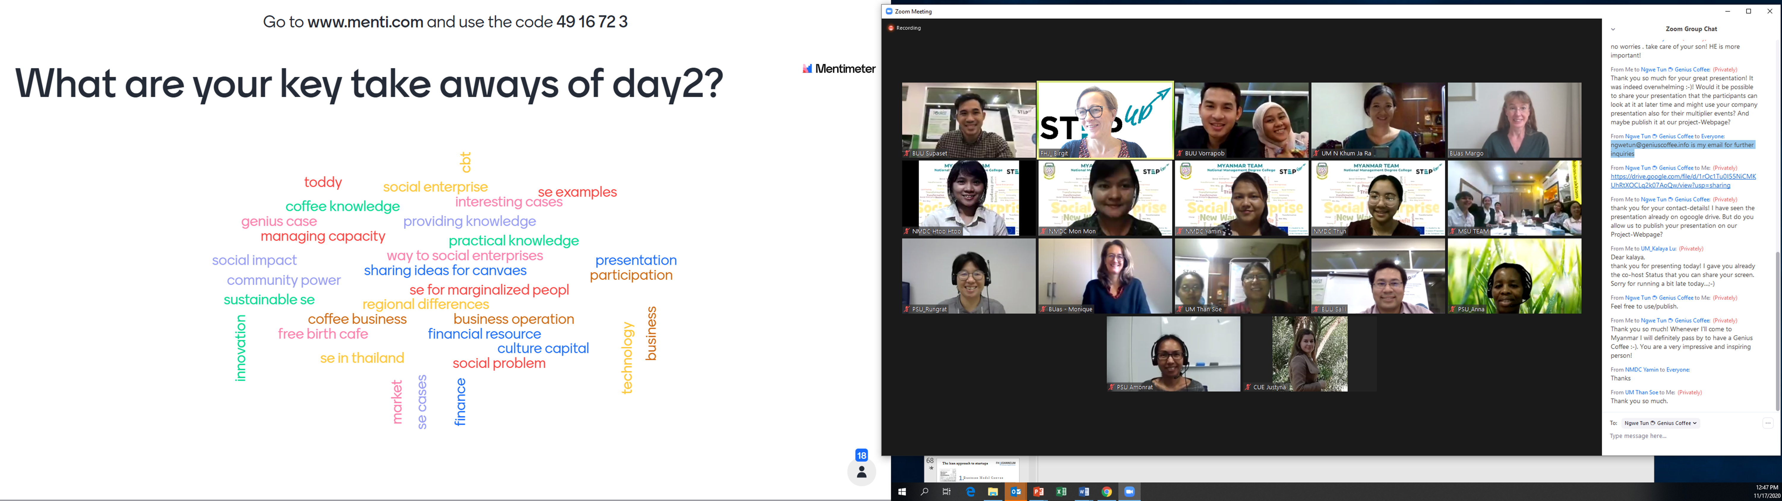

Slide 9
Erasmus+ Capacity Building in Higher Education
Strengthening innovative social
entrepreneurship practices for disruptive business settings in Thailand and Myanmar
Projectref.: 609711-EPP-1-2019-1-AT-EPPKA2-CBHE-JP
Duration: 36 Months (15/01/2020-14/01/2023)

